Slide 1
BANK MARKETING Prediction
By
Gnandev Rathod

Slide 2
Data and goals
In this project we study different approaches to predict the success of bank marketing campaign.
The main goal of this Marketing Campaign is whether the customers will respond to the campaign positively or not.
Marketing Campaign is nothing but phone calls to the clients to make them accept to make a term deposit with their bank.

Slide 3
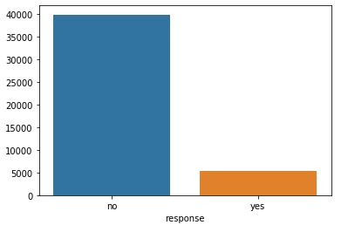
Distribution of target variable

Slide 4
Exploratory Data analysis
Data set consists information of 41000 clients with 19 feature columns.
Data is consisted of both Categorical and Numerical Data.
As we saw the distribution of the Target Variable with binary output YES(1) and NO(0) we can say that this is a Classification Problem.
There is no Null data present in the data set.

Slide 5
data preparation
Features were having Null values in the Categorical Features.
So in order to handle this null values we use a method called imputation by handling the null values of one feature with another feature.
We have many methods of Imputation, and the method I used for this data set is called Cross Tabulation.
We check the correlation values to know the dependency between the two variables.

Slide 6
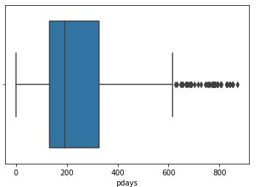
Outliers

Slide 7
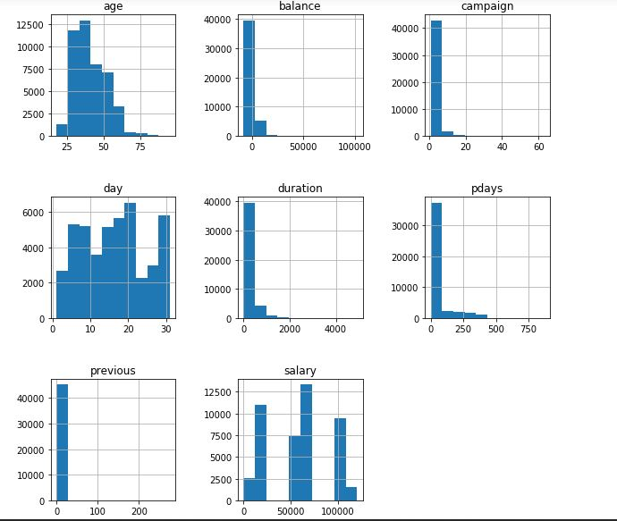
numerical features

Slide 8
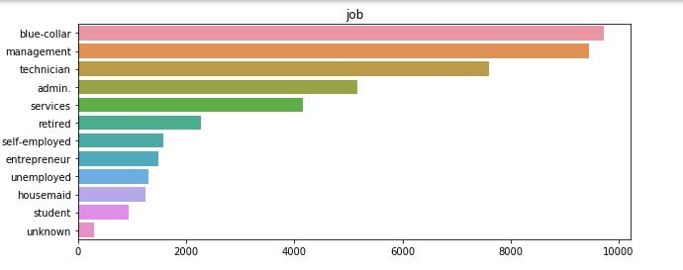
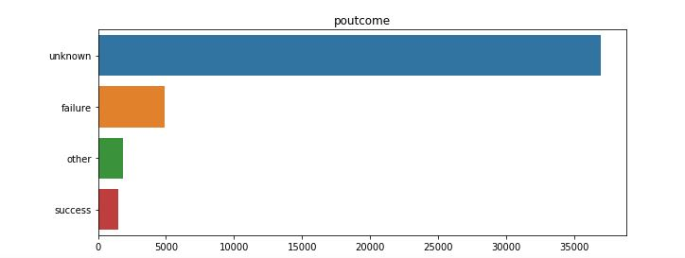
categorical features

Slide 9
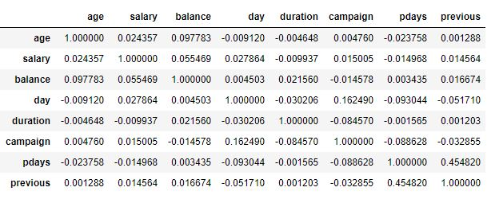
Correlation values

Slide 10
machine learning model building
For Classification Model , we here used two different kinds of Machine Learning Models.
They are:
Logistic Regression
Random Forest
Logistic Regression fits a sigmoid function to the data which classifies the data according to the Target Variable.
Random Forest constructs multiple tress and validation set is used to optimise the forest level parameters.

Slide 11
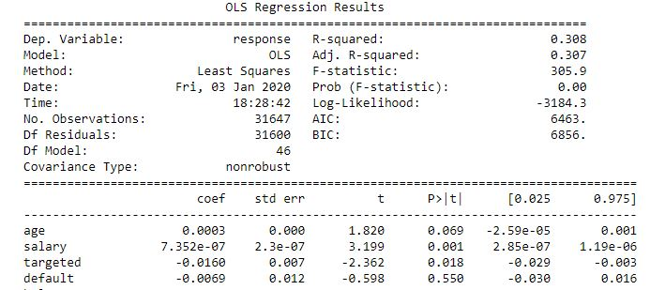
feature selection
The most significant features of the data are identified by a method called Feature selection in Feature Engineering.
Recursive Feature Elimination
Variance Inflation Factor and
Ordinary Least Square Summary

Slide 12
model evaluation
Model is evaluated by three well known metrics
Precision and Recall metric
Accuracy Score and
K-Fold Cross Validation

Slide 13
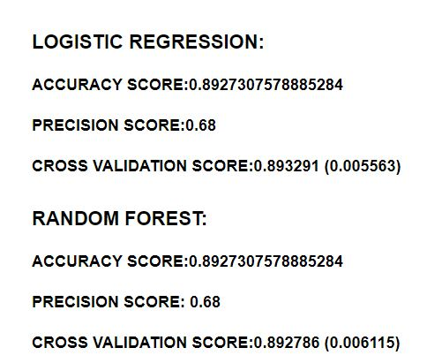

model evaluation measurements

Slide 14
results
Logistic Regression with selected features gives better accuracy with the measure of Cross Validation Score.
By applying logistic and Random forest classification algorithms estimation model were successfully built.
The targeted customer has the highest Probability and the response is more positive in the months of June, July and August.
Bank must prioritize those customers who were part of previous marketing campaign.

Slide 15
Thankyou

